Slide 1
TRIES

Slide 2
Applications in implementation of Dictionaries
Suppose we need to store a dictionary with following words
Assoc
Algo
Also
Tree
Trie
All

Slide 3
One possible solution is Hashing

Slide 4
Better to use Trie!

Slide 5
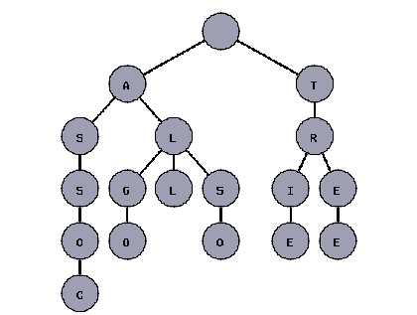
*
*
*
*
*
*

Slide 6
Deletion Cases :
String to be deleted has no relation with any other string
String to be deleted is prefix of another string in the dictionary
Prefix of the string is a word in the dictionary
Prefix of the word is prefix of some other string in the dictionary

